Slide 1
Evaluation Project II
Open Scope

Slide 2
Theme
Objectives, problems and answers

Slide 3
Problematic
Have you ever wondered what do you eat?
You are what you eat.

Slide 4
Solution - Proposition
Help people understand what’s the composition of the things they eat on their daily lives.

Slide 5
The REST API – F.C.M.
Food Calorie Meter – FCM
API REST that will allow users to create and manage lists of foods and see the total amount of vitamins, minerals, proteins, fats and energetic values.

Slide 6
Objective
Create a list of foods – Charts – and calculate the total nutritional value.
Create and manage food charts.
Enable users to create their accounts and manage as many lists possible.
Authentication service
Stateless - Tokens
Alter user data.

Slide 7
External API
How it’s done

Slide 8
Food Data Center
Government API REST
Departament of Agriculture of the United States
FoodData Central
Food Database
Collections of a pletora of data about food, nutrition and other info.
The project use it’s data to calculate nutritional value of the chart

Slide 9
MyMemory
Translation API
MyMemory - Translation Memory API | RapidAPI
Since the API have it’s target audience portuguese speakers, there’s a need to translate from list to the FDC.
Enables to write the lists in portuguese.

Slide 10
Overview
Model, layers and operation

Slide 11
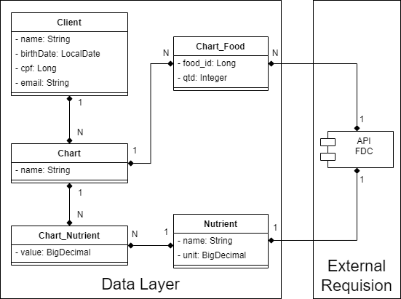
API Model

Slide 12
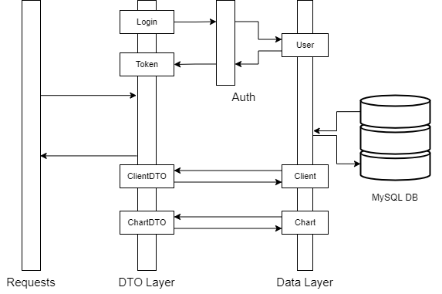
Operation Layer

Slide 13
Endpoints
Authentication
Allows the user to create and request access to the API
POST: /auth/client/registry: create user
POST: /auth/client: login
Client Management
Allows the user to view and edit their data
GET: /client: view data sent
PUT: /client: edits data
Chart Management
Allows the creation and edition of food charts
GET: /chart: View charts created by the user
POST: /chart: Edits chart data, allows to add more quantities

Slide 14
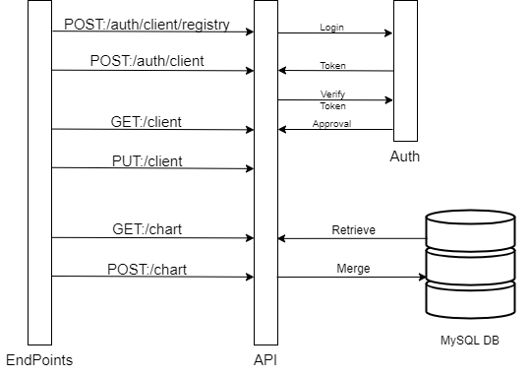
Endpoints

Slide 15
Operation
Let’s test it out

Slide 16
Thank You
Questions?

